Slide 1
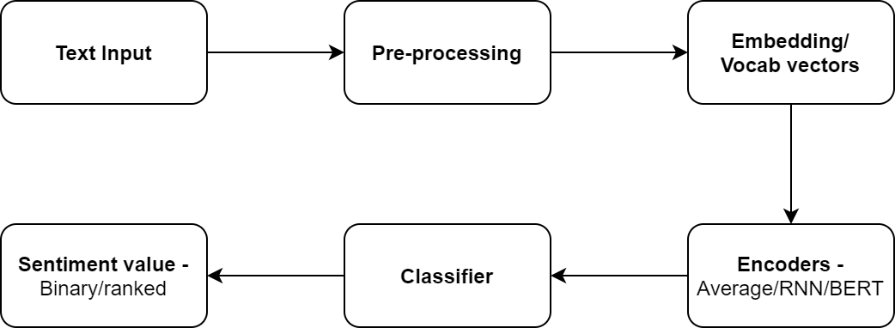
Sentiment Analysis components

Slide 2
Embedding / Vocab vectors
Tokens in the sentence are replaced with vectors that encode the meaning of the word (embeddings).
Embeddings may be trained with data from a particular domain or using universal corpus.

Slide 3
Encoders
This component takes the embeddings of words in a sequence and tries to derive meaning from the sequence of embeddings in terms of a sentence/document encoding.
Example encoder functions
Averaging of word embeddings
RNN – LSTM/GRU
BERT
Tensorflow universal sentence encoder
The final vector represents some meaning of the input sentence in a form that can be used by a classifier.

Slide 4
Classifier
Can be any of the machine learning techiques.
Examples include
SVM
Conditional Random Fields
Neural Networks

Slide 5
Links
Twitter API - http://docs.tweepy.org/en/v3.5.0/api.html
Code for downloading realtime posts - https://github.com/feconroses/gather-tweets-from-stream/blob/master/stream.py
Example project using nltk - https://github.com/saodem74/Sentiment-Analysis-facebook-comments
Example project using Textblob - https://github.com/mehdiassefi/Sentiment-Analysis-on-Social-Media
Example using fuzzy rules - https://github.com/SrishtiVashishtha/Fuzzy-Rule-based-Unsupervised-Sentiment-Analysis-from-Social-Media-Posts
Example using spacy and keras - https://github.com/explosion/spaCy/blob/master/examples/deep_learning_keras.py
Datasets for topic detection - https://www.cs.umb.edu/~smimarog/textmining/datasets/
Refinitiv Data API - https://developers.refinitiv.com/eikon-apis/eikon-data-api/quick-start

